Slide 1

Module 13: Configuring the SRMW for Global Deployments
0/5
Analytics: Advanced Data Warehouse Developer
Notes:
Time: Lecture: 15 – 20 minutes; Labs: no lab
Intent: To learn to configure the SRMW for global deployments.
Flow: Describe the code page; describe the compatibility between code pages, list the code pages supported for SRMW global deployments, and how to lift code page restrictions; review installation and configuration considerations for Oracle, SQL Server, and DB2 databases
Key Terms:
Code Page
Code Page Compatibility
Oracle
SQL Server
DB2
UNIX
Unicode
13

Slide 2
Module Objectives
After completing this module you will be able to:
  Describe code page and code page compatibility
  Select appropriate settings for Informatica servers and the Siebel Relationship Management Warehouse (SRMW) database for global deployments
Why you need to know:
  You need to select appropriate settings to avoid data inconsistencies when loading the SRMW in a global deployment
Notes:
Each objective and “why you need to know” should be stated aloud.

Slide 3
Code Page
Contains the encoding to specify characters in a set of one or more languages
Influences the way an application stores, receives, and sends data from source databases to the SRMW
Is used to identify data that might be in a different language
  For example, Japanese code page is used to load Japanese data
Notes:
This slide provides an overview of code page.
13

Slide 4
Choosing Code Pages
Choose code pages based on the character data you are using in Extraction, Transformation, and Loading (ETL) mappings
  Character data is represented by character modes based on the character size
  Character size is measured by the amount of storage space a character requires in the database
    Single byte
    Double byte
    Multi byte
Notes:
Choosing a code page allows an application to refer to a specific set of data that describes the characters the application recognizes.

Slide 5
Code Page Compatibility
Compatibility between code pages is essential to accurately move data between source database and SRMW in a global deployment
Incompatible code pages can cause data inconsistencies during the ETL load
Notes:
This slide describes the significance of compatibility between different code pages. Incompatible code pages can result in gibberish characters in the SRMW simply because the target code page may not understand the characters of the source code page.
13

Slide 6
Code Page Compatibility Continued
Compatible code pages contain identical encoded characters
  For example, IBM EBCDIC US English and Latin-1 code pages are compatible with each other
  Informatica can pass data back and forth between two compatible code pages without data loss
Compatibility is based on whether a code page is a superset or subset of another code page
  Superset – Contains characters encoded in another code page
  Subset – All characters in the code page are also encoded in another code page
Notes:
The code page compatibility is all about whether a code page is a subset or superset of another code page.

Slide 7
Code Page Compatibility Continued
To ensure accurate data movement:
  The Siebel data warehouse code page must be a superset of the source, Informatica Server, and Informatica Repository Server code pages
  The Informatica Server and Informatica Repository Server code pages must be a superset of the source code page
Code page compatibility between Source, Target, Informatica Server, and Informatica Repository Server
Target
Informatica /
Repository
Servers
Source
Notes:
This slide describes the code page compatibility relationship between sources, targets, and Informatica repository servers.
13

Slide 8
SRMW Global Deployment
0/5
The following source and target code page configurations are supported for deploying SRMW globally
  Latin-1 General to Latin-1 General (7-bit ASCII)
  Latin-1 General to Latin-1 General (8-bit ASCII)
  Unicode to Unicode
  Code Page to Unicode
  Code Page to Code Page
Notes:
This slide lists the various source and target code page configurations that are supported for global deployments. More information on this can be found in the bookshelf, Siebel Analytics Applications Installation and Administration Guide.

Slide 9
1. Latin-1 General to Latin-1 General (7-bit ASCII)
1/5
7-bit ASCII is the character set used for the English
The following code page options are supported for the Informatica Server and Repository Server running on Windows and UNIX ENU (English)
Component Code Page | Code Page
Source code page | MS Windows Latin 1 (ANSI), superset of Latin 1
Data Warehouse code page | MS Windows Latin 1 (ANSI), superset of Latin 1
Informatica Repository code page | MS Windows Latin 1 (ANSI), superset of Latin 1 (Windows) ISO 8859-1 Western European (UNIX)
Informatica Server code page | MS Windows Latin 1 (ANSI), superset of Latin 1 ISO 8859-1 Western European (UNIX)
Notes:
This slide provides the code page configurations for Latin-1 General (7-bit ASCII) to Latin-1 General (7-bit ASCII).
13

Slide 10
2. Latin-1 General to Latin-1 General (8-bit ASCII)
2/5
8-bit ASCII is the character set used for Western European languages that use accented Roman characters
The following code page options are supported for the Informatica Server and Repository Server running on Windows and UNIX ENU
Component Code Page | Code Page
Source code page | ISO 8859-1 Western European
Data Warehouse code page | ISO 8859-1 Western European
Informatica Repository code page | MS Windows Latin 1 (ANSI), superset of Latin 1 (Windows) ISO 8859-1 Western European (UNIX)
Informatica Server code page | MS Windows Latin 1 (ANSI), superset of Latin 1 (Windows) ISO 8859-1 Western European (UNIX)
Notes:
This slide provides the code page configurations for Latin-1 General (8-bit ASCII) to Latin-1 General (8-bit ASCII).

Slide 11
3. Unicode to Unicode
3/5
The following code page options are supported for the Informatica Server and the Repository Server running on Windows and UNIX ENU
  UTF8 and AL32UTF8 are supported for Oracle
  UCS-2 is supported for DB2
Component Code Page | Code Page
Source code page | UTF-8 encoding of Unicode
Data Warehouse code page | UTF-8 encoding of Unicode
Informatica Repository code page | MS Windows Latin 1 (ANSI), superset of Latin 1 (Windows) ISO 8859-1 Western European (UNIX)
Informatica Server code page | MS Windows Latin 1 (ANSI), superset of Latin 1 (Windows) ISO 8859-1 Western European (UNIX)
Notes:
This slide provides the code page configurations for Unicode to Unicode.
13

Slide 12
4. Code Page to Unicode
4/5
The following code page options are supported for the source databases:
  JPN16JIS for Oracle
  943 for DB2
The following code page options are supported for the Siebel data warehouse databases:
  UTF8 and AL32UTF8 are supported for Oracle
  UCS-2 is supported for DB2
Notes:
This slide provides the code page configurations for Code Page to Unicode.

Slide 13
4. Code Page to Unicode Continued
4/5
The following code page options are supported for the Informatica Server and the Repository Server on Windows and Unix on <LANG>
Japanese code page example is used. Replace it with appropriate code page for other languages
Component Code Page | Code Page <LANG> = JPN
Source code page | MS Windows Japanese, superset of shift JIS
Data Warehouse code page | MS Windows Japanese, superset of shift JIS
Informatica Repository code page | MS Windows Japanese, superset of shift JIS
Informatica Server code page | MS Windows Japanese, superset of shift JIS
Notes:
See previous slide.
13

Slide 14
5. Code Page to Code Page
5/5
The following code page options are supported for the source databases:
  JPN16JIS for Oracle
  943 for DB2
The following code page options are supported for the Siebel data warehouse databases:
  UTF8 and AL32UTF8 are supported for Oracle
  UCS-2 is supported for DB2
Notes:
This slide provides the code page configurations for Code Page to Unicode.

Slide 15
5. Code Page to Code Page Continued
5/5
The following code page options are supported for the Informatica Server and the Repository Server on Windows and UNIX on <LANG>
Japanese code page example is used. Replace it with appropriate code page for other languages
Component Code Page | Code Page <LANG> = JPN
Source code page | MS Windows Japanese, superset of shift JIS
Data Warehouse code page | MS Windows Japanese, superset of shift JIS
Informatica Repository code page | MS Windows Japanese, superset of shift JIS (Windows and UNIX)
Informatica Server code page | MS Windows Japanese, superset of shift JIS (Windows and UNIX)
Notes:
See previous slide.
13

Slide 16
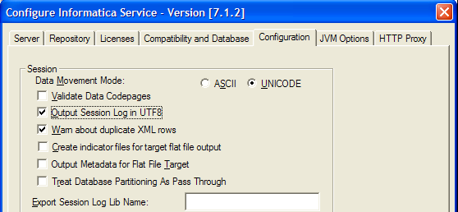
Unicode Configuration for Informatica
Configure the Informatica Server service for the Unicode
  Select UNICODE as the data movement mode for Informatica
  Disable the data code page validation
  Specify to write to the session log using the UTF-8 character set
  Restart the Informatica Server service
Notes:
This slide details the process to configure Informatica Server service for the Unicode.

Slide 17
Unicode Configuration for Informatica Continued
Run the Informatica Server in Unicode mode if the source data contains multibyte or ISO 8859-1 (8-bit ASCII) data
Set the PMREPCODEPAGE environment variable if the Informatica Server is running on UNIX
  setenv PMREPCODEPAGE <PMREPCODEPAGE value>
  For example, setenv PMREPCODEPAGE 1208
Notes:
This slide details the process for additional Unicode related configuration for Informatica.
13

Slide 18
Additional Considerations for Unicode
Use Unicode character data mode if you are installing the Siebel Data Warehouse in a UNIX environment
Set the SiebelUnicodeDB environment variable for the Unicode
Notes:
This slide lists additional consideration that need be taken into account when using the Unicode code page for the SRMW.

Slide 19
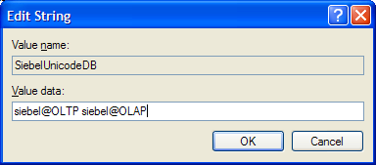
Additional Configurations for Unicode—Windows
Use the Registry Editor to set the value for SiebelUnicodeDB system environment variable
  Navigate to HKEY_LOCAL_MACHINE > SYSTEM > CurrentControlSet > Services > PowerMart > Parameters > Configuration
  Set the string value for SiebelUnicodeDB
    [user_OLTP]@[ConnectString_OLTP] [user_OLAP]@[ConnectString_OLAP]
    For example, siebel@OLTP siebel@OLAP
Notes:
This slide details the steps to set the value for SiebelUnicodeDB variable in Windows.
13

Slide 20
Additional Configurations for Unicode—UNIX
Modify the pmserver.cfg file where the Informatica Server is installed
  Add the string value for SiebelUnicodeDB
    For example, SiebelUnicodeDB=siebel@OLTP siebel@OLAP
Notes:
This slide details the steps to set the value for SiebelUnicodeDB variable in UNIX.

Slide 21
Relaxed Data Code Page Validation
Disable the code page validation for:
  Different sources using character sets from different languages using the same repository
  Sources and targets with incompatible code pages
  Sources and targets with code pages incompatible with the Informatica Sever code page
Configure the Informatica Server service for relaxing the data code page validation
  The steps are identical to configuring the Informaitca Server service for Unicode data movement
Notes:
Although relaxed data code page validation lifts source and target code page restrictions, it may also result in possible data inconsistencies when moving data between two incompatible code pages. So, care should be taken before relaxing the code page restrictions.
13

Slide 22
Oracle Installation Notes
0/2
Set the NLS_LANG environment variable before installing the SRMW components
  Determine the NLS_LANG value
  Set the NLS_LANG value
Notes:
This slide details additional configuration steps for SRMW installed on Oracle database.

Slide 23
1. Determine the NLS_LANG Value
1/2
Execute the following command in the Siebel data warehouse from the Informatica Server machine
  SELECT * FROM V$NLS_PARAMETERS
Make a note of the NLS_LANG value which is in the following format
  [NLS_LANGUAGE] _ [NLS_TERRITORY].[NLS_CHARACTERSET]
  For example, American_America.UTF8
Notes:
This slide describes the process to determine the NLS_LANG value.
13

Slide 24
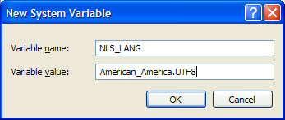
2. Set the NLS_LANG Value—Windows
2/2
Create a new system environment variable in the Informatica Server machine
  Navigate to Control Panel > System and click the Advanced Tab
Initialize the system variable with the NLS_LANG value
  The format should be:
  [NLS_LANGAUGE]_[NLS_TERRITORY].[NLS_CHARACTERSET]
Reboot the machine after initializing the variable
Notes:
This slide describes the steps to set the NLS_LANG value in Windows.

Slide 25
2. Set the NLS_LANG Value—UNIX
2/2
Enter the following at the UNIX prompt from the Informatica Server machine
  setenv NLS_LANG <NLS_LANG>
  For example, setenv NLS_LANG American_America.UTF8
Enter the following if your data is 7-bit or 8-bit ASCII and the Informatica Server is on UNIX
  setnv NLS_LANG <NLS_LANG>_<NLS_TERRITORY>.WE8ISO8859P1
Reboot the machine after initializing the variable
Notes:
This slide describes the steps to set the NLS_LANG value in UNIX.
13

Slide 26
DB2 Installation Notes
0/2
Set the DB2CODEPAGE environment variable before installing the SRMW components
  Determine the DB2CODEPAGE value
  Set the DB2CODEPAGE value
Notes:
This slide details additional configuration steps for SRMW installed on DB2 database.

Slide 27
1. Determine the DB2CODEPAGE Value
1/2
Execute the following command in the Siebel data warehouse from the Informatica Server machine
  SELECT CODEPAGE
  FROM SYSCAT.DATATYPES
  WHERE TYPENAME = ‘VARCHAR’
Make a note of the DB2CODEPAGE value
  For example, 1208
Notes:
This slide describes the process to determine the DB2CODEPAGE value.
13

Slide 28
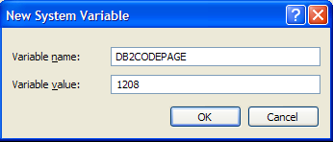
2. Set the DB2CODEPAGE Value—Windows
2/2
Create a new system environment variable in the Informatica Server machine
  Navigate to Control Panel > System and click the Advanced Tab
Initialize the system variable with the DB2CODEPAGE value
Reboot the machine after initializing the variable
Notes:
This slide describes the steps to set the value for the DB2CODEPAGE variable in Windows.

Slide 29
2. Set the DB2CODEPAGE Value—UNIX
2/2
Enter the following at the UNIX prompt from the Informatica Server machine
  setenv DB2CODEPAGE <DB2CODEPAGE value>
  For example, setenv DB2CODEPAGE 1208
Reboot the machine after initializing the variable
Notes:
This slide describes the steps to set the value for the DB2CODEPAGE variable in UNIX.
13

Slide 30
SQL Server Installation Notes
0/2
Use ODBC connection instead of native connection when running on Unicode to avoid data corruption
  Create new ODBC connection
  Replace connection
Notes:
This slide details additional configuration steps for SRMW installed on Microsoft SQL Server database.

Slide 31
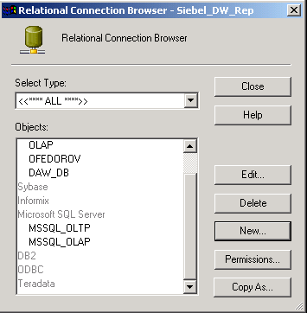
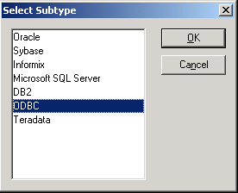
1. Create New ODBC Connections
1/2
Select Connections > Relational in the Informatica Workflow Manager
Select ODBC for the subtype
Notes:
This slide details the process to create relational ODBC connections in Informatica Workflow Manager.
13

Slide 32
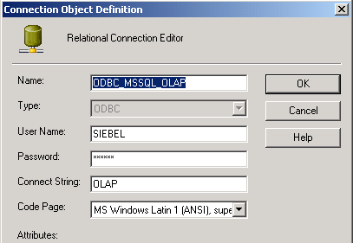
1. Create New ODBC Connections Continued
1/2
Specify the username, password, and ODBC data source name for the new relational connection
Notes:
It is a good practice to prefix the subtype such as ODBC or MSSQL to the relational connection name.

Slide 33
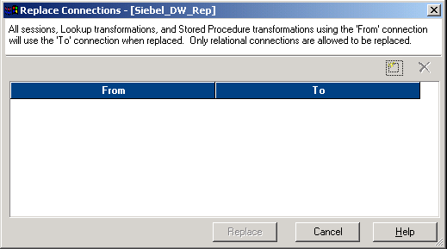
2. Replace Connection
2/2
Select Connections > Replace in the Informatica Workflow Manager
Adds a new connection pair for replacement
Notes:
This slide details the steps to replace the connections in the Informatica Workflow Manager.
13

Slide 34
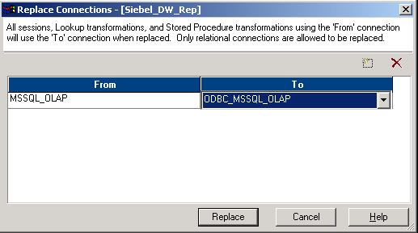
2. Replace Connection Continued
2/2
Replace the native SQL Server connection with the newly created ODBC connection
Notes:
Point out that replacing the connection here replaces the connection details for all sessions. If there is a need to replace the connections for a selected set of sessions, then changes should be made directly to those sessions and not here.

Slide 35
Summary
This module showed you how to:
  Describe code page and code page compatibility
  Select appropriate settings for Informatica servers and the Siebel Relationship Management Warehouse (SRMW) database for global deployments
Notes:
This slide presents a summary of the topics covered in the module.
13

